Slide 1



Building Modular Monolith Applications with ASP.NET Core and ABP Studio
Halil İbrahim KALKAN Volosoft, Lead Software Architect
@hibrahimkalkan
@hikalkan

Slide 2
Agenda
01
02
03
Introduction to Modularity & ABP Platform
Designing a Modular .NET Solution
DEMO: Building Modular Application with ABP Studio

Slide 3
01
Introduction to Modularity & ABP Platform

Slide 4

Why Modular Software?
Reducing & managing code complexity
On-premise modular deployment
Migrating to microservices later

Slide 5
The Need for An Infrastucture
Team 1
Team 2
Team 3
Catalog
Ordering
Shipping
Reviews
Infrastructure Team
Base classes & utilities
Entities, repositories, services, controllers, DTOs, Helpers ☺
Automating cross-cutting concerns
Authorization, validation, database transaction, exception handling...
Enterprise application building blocks
audit logging, background jobs, BLOB storing, data filtering, distributed locking, setting management, event bus, multi-tenancy...
Abstractions for 3-rd party libraries and services
rabbitmq, redis, hangfire, twilio, ...

Slide 6
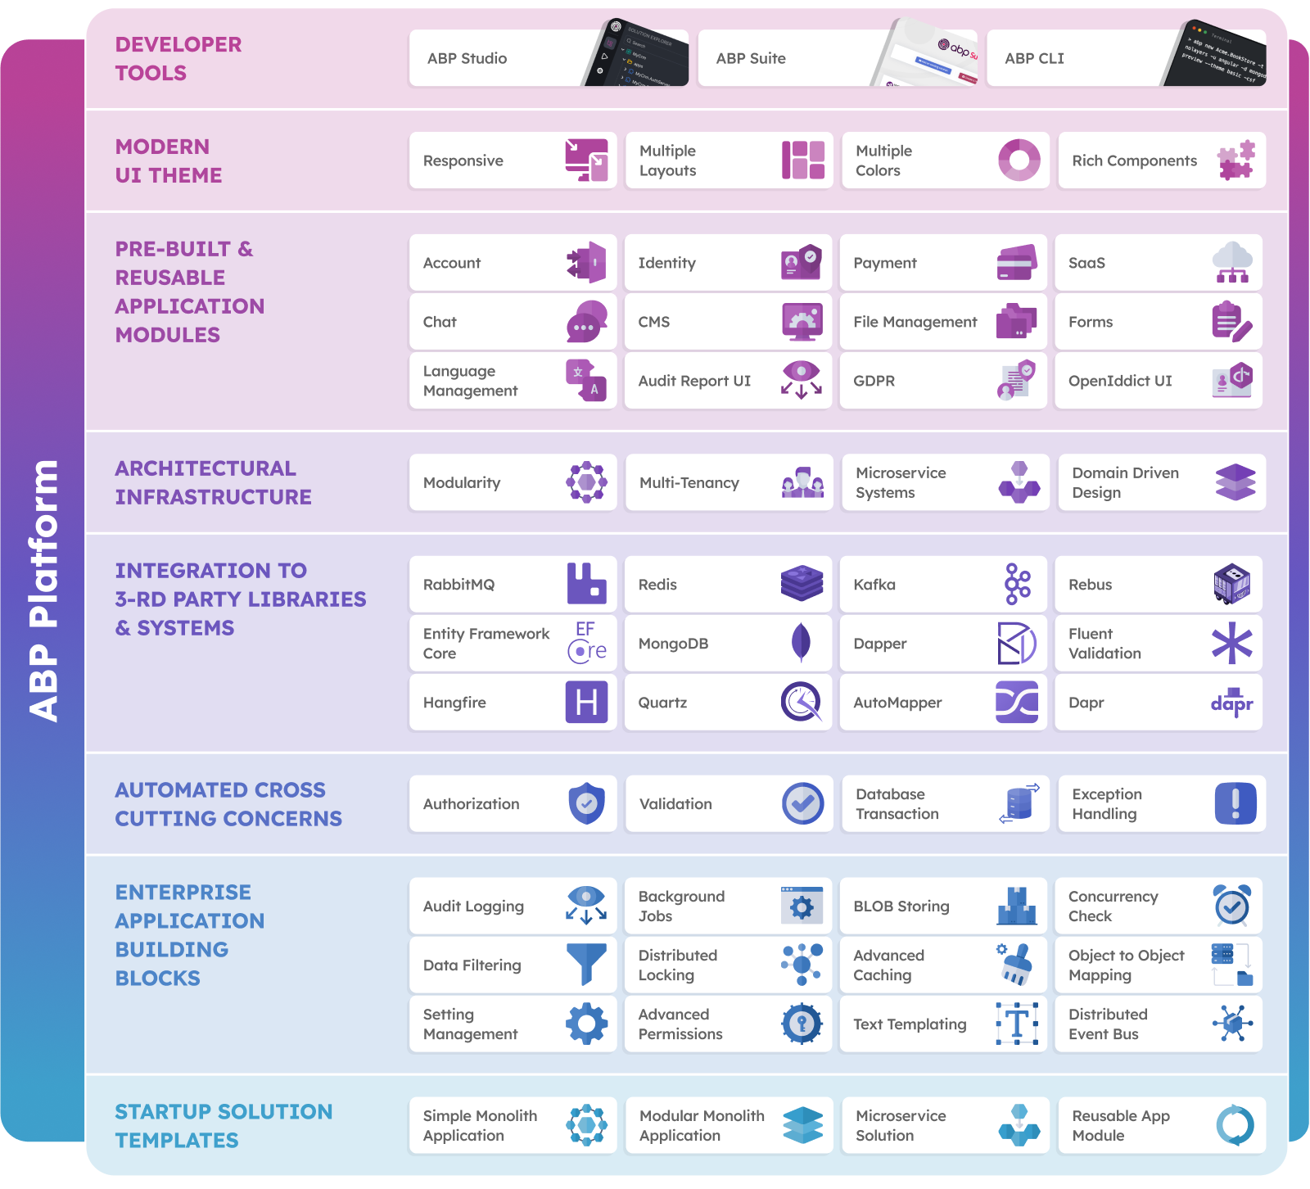
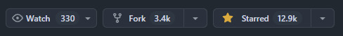
The ABP Platform
Modular Application Development Platform for .NET Developers
https://abp.io
https://github.com/abpframework

Slide 7
02
Designing a Modular .NET Solution

Slide 8
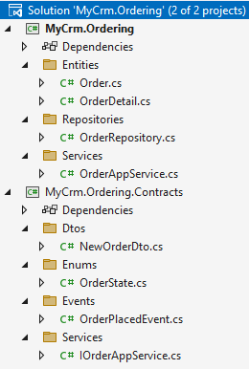
Module: Package Structure
MyCrm.Ordering -> Implementation
Entities, Repositories, Services, etc..
MyCrm.Ordering.Contracts -> Interface
Service interface, DTOs
Event definitions
Enums, constants, etc..
Optional Packages:
UI
Test

Slide 9
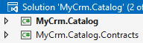
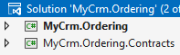
Module Dependencies
Ordering Module -> IProductService.CheckStockCount(id)
Catalog module -> Subscribe to OrderPlaced & OrderCanceled events

Slide 10

Communication Between the Modules
Integration Services (API Calls)
Integration Events
UI Application
UI Application
place
order
place
order
monolith host (single process)
monolith host (single process)
event OrderPlaced
Ordering Module
query stock
Catalog Module
Ordering Module
Catalog Module
ordering database
catalog database
ordering database
catalog database
Best for read / query operations
Implement side effects (a change triggers another change in other modules)

Slide 11
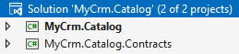
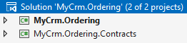
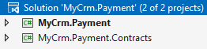
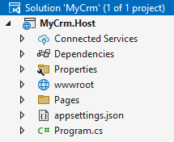
Module Solutions & The Host Application

Slide 12
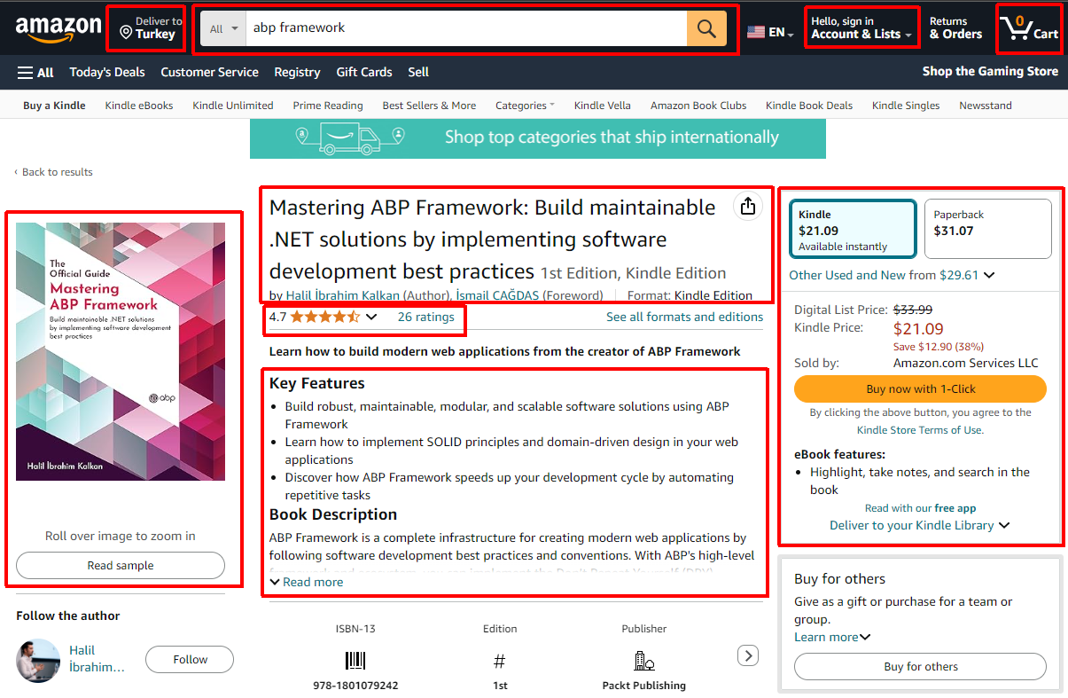
The UI Layer
UI Packages for Each Module (pages & components)
A Unification UI Layer

Slide 13

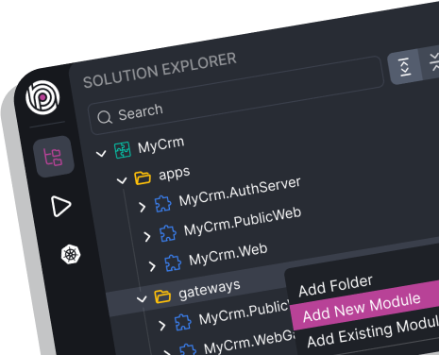
Building Modular Applications with ABP Studio
DEMO

Slide 14

Modular Monolith Application Development Tutorial
Part 01: Creating the initial solution
Part 02: Creating the initial Products module
Part 03: Building the Products module
Part 04: Creating the initial Ordering module
Part 05: Building the Ordering module
Part 06: Integrating the modules: Implementing Integration Services
Part 07: Integrating the modules: Communication via Messages (Events)
Part 08: Integrating the modules: Joining the Products and Orders Data

Slide 15
Thank you!
https://abp.io
Halil İbrahim KALKAN Volosoft, Lead Software Architect
@hibrahimkalkan
@hikalkan

Slide 16
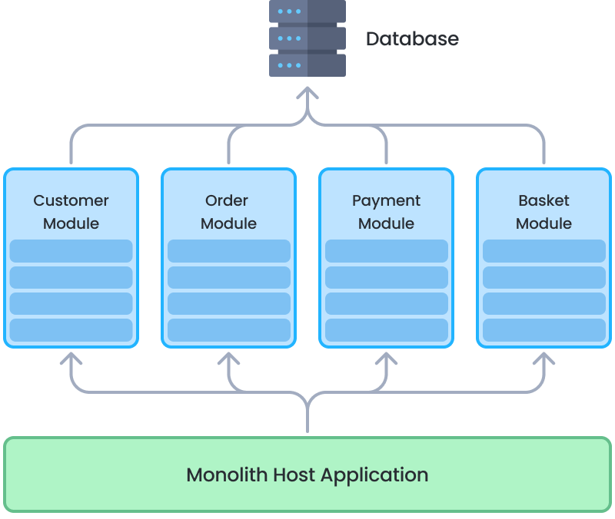
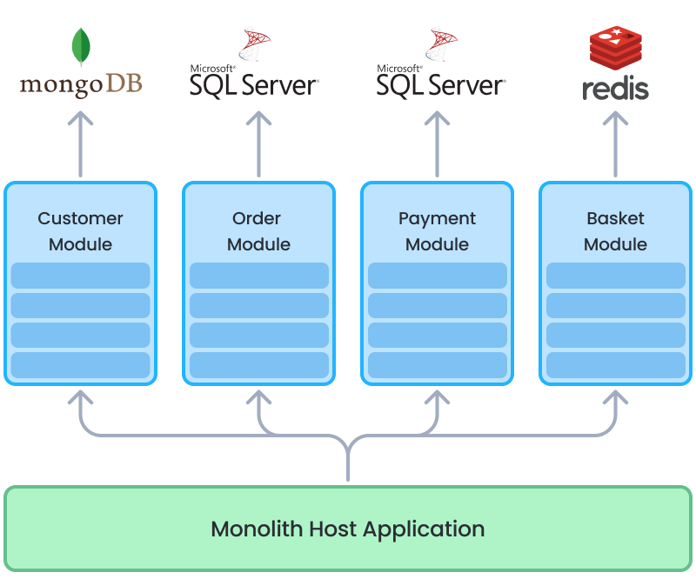
The Database Layer
Single (shared) Database
Separate Databases
Possible to make multi-module table JOINs (for reporting)
Possible to ensure database level transactions
Best data isolation
Different DBMS for each module
Scale a database independently
More microservice ready

Slide 17
Module Types
Business Modules
Infrastructure Modules
Catalog
Ordering
Shipping
User reviews
Setting management
Permission management
Background jobs
Email & SMS Sending
Aggregator Modules
Generic Modules
Reporting
Dashboard
User & role management
Audit logging
GDPR
Chat

